Slide 1
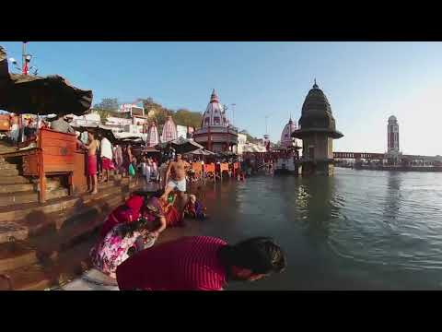

Slide 2
1. Where does the Ganges River become polluted?
2. Why does the Ganges continue to become polluted?
3. Name 2 things that people do at the Ganges in the city of Varanasi.
After you are done watching the video, watch it a second time and use the icon in the upper left-hand corner to view the video 360 degrees. As you do this, answer the last question.
3. Describe the Ganges where it forms (beginning of the video) and describe it as it moves south (end of video)

